Slide 1
CS 419 Project
Mastering Atari Pong using
Deep Reinforcement Learning
~ Team Brogrammers
Arpit Saxena (180040019)
Kritti Sharma (180100060)
Shreyas Chandgothia (180260037)
Shubham Lohiya (18D100020)

Slide 2
OUTLINE
INTRODUCTION
Reinforcement Learning
Problem Statement
DEEP Q-NETWORK
Q-Learning Algorithm
Pong Emulator
Network Architecture
Results
CONCLUSION
Discussion & Future Work
Summary
PAST WORKS
Background
Related Work
MODIFICATIONS
Double Deep Q-learning Algorithm
Results

Slide 3
INTRODUCTION TO RL
Reinforcement Learning (RL): Agent interacts with the environment in a sequence of actions, observations and rewards. At each time-step, the agent chooses an action which modifies the state and assigns a reward.
Deep Learning (DL): Extract high-level features from raw sensory data by utilizing a wide range of neural network architectures like convolutional neural networks, multilayer perceptrons, restricted Boltzmann machines and recurrent neural networks
Implementation of similar techniques in RL can be very challenging from a DL perspective:
DL requires large amounts of hand-labelled data whereas RL requires us to learn from a scalar reward signal which can be sparse, noisy and delayed.
Data in DL is almost always assumed to be independent, whereas in RL, the states can be highly correlated. Moreover, this data distribution is subject to change as our RL algorithm learns, whereas DL assumes a fixed underlying data distribution.

Slide 4
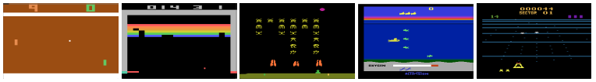
PROBLEM STATEMENT
We aim to develop a system that uses Deep Reinforcement Learning (Deep RL) to play the Atari game, Pong. The system is to be trained purely from the pixels of a frame from the video-game display as its input, without having to explicitly program any rules or knowledge of the game.
We also aim that the system does not learn only a pong-specific strategy, but also generalize well and beat human-level performance across multiple other games (especially Atari games).
Screenshots from five Atari 2600 games: (Left-to-right) Pong, Breakout, Space Invaders, Seaquest, Beam Rider

Slide 5
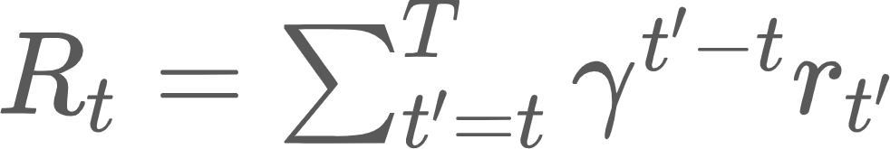
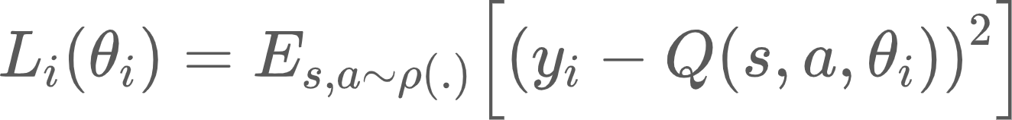
BACKGROUND
We consider a series of actions and rewards to learn the game strategies which are based on these observations. This formalism leads to a large Markov Decision Process (MDP) problem where the goal of the agent is to learn the actions which maximizes the future rewards.
Future Discounted Return:
The optimal Action Value Function:
In deep RL, a linear function approximator is used to estimate this action value function and the NN function approximator is trained by minimising a sequence of loss functions:
where θ_{i} are the weights, y_{i} is the target for the ith iteration and ρ(s,a) is the probability distribution over the sequences and actions.
This loss function is optimised using stochastic gradient descent.

Slide 6
RELATED WORK
TD Gammon:
Backgammon playing program which learnt entirely by model-free RL algorithm and self-play, thus achieving superhuman levels of play
Approximated the value function using a multi-layer perceptron with one hidden layer
Neural Fitted Q-learning:
Optimizes the sequence of loss functions using the RPROP algorithm to update the parameters of the Q-Network
Uses a batch update that has a computational cost per iteration that is proportional to the size of the data set
Successfully applied to simple real-world control tasks using purely visual input, by first using deep autoencoders to learn a low dimensional representation of the task, and then applying NFQ to this representation

Slide 7
DEEP Q-LEARNING WITH EXPERIENCE REPLAY
Initialize replay memory D to capacity N
Initialize action-value function Q with random weights
for episode = 1 to M do
Initialise sequence s₁ = {x₁} and preprocessed sequenced Φ₁ = Φ(s₁)
for t = 1 to T do
With probability ε select a random action a_{t}
otherwise select a_{t} = max_{a} Q*(Φ(s_{t}), a; θ)
Execute action a_{t} in emulator and observe reward r_{t} and image x_{t+1}
Set s_{t+1} = s_{t}, a_{t}, x_{t+1} and preprocess Φ_{t+1} = Φ(s_{t+1})
Store transition (Φ_{t}, a_{t}, r_{t}, Φ_{t+1}) in D
Sample random minibatch of transitions (Φ_{j}, a_{j}, r_{j}, Φ_{j+1}) from D
Set y_{j} = r_{j} for terminal Φ_{j+1}, or y_{j} = r_{j} + max_{a’} Q(Φ_{j+1}, a’; θ) for non-terminal Φ_{j+1}
Perform a gradient descent step on (y_{j} - Q(Φ_{j}, a_{j}; θ))²

Slide 8
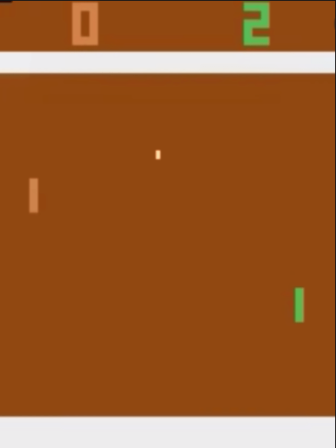
PONG EMULATOR
Open AI Gym Environment: PongNoFrameskip-v4
Observation - 210 x 160 pixel images with 128 color palette
Images are preprocessed by grey-scaling, down-sampling, cropping into an 84 x 84 image.
Frames are received with a skip of 4
4 last frames from the history are stacked to obtain input of size 4 x 84 x 84
This is done so that the agent can judge velocity
Action Space - The agent can perform 6 actions :-
['NOOP', 'FIRE', 'RIGHT', 'LEFT', 'RIGHTFIRE', 'LEFTFIRE']

Slide 9
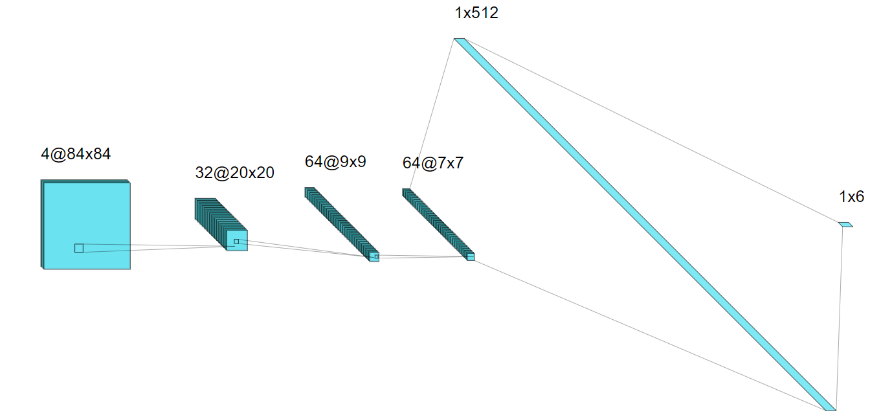
DEEP Q-NETWORK (DQN) ARCHITECTURE
Dense (FC)
Layer + ReLU
Dense (FC)
Layer
2D Convolutional
Layer + ReLU
2D Convolutional
Layer + ReLU
2D Convolutional
Layer + ReLU

Slide 10
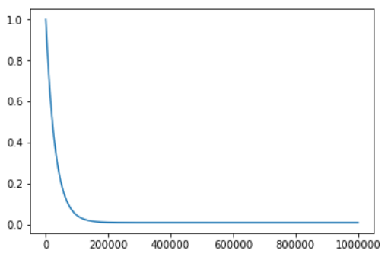
TRAINING SPECIFICATIONS AND HYPERPARAMETERS
EPISODES = 800, ADAM OPTIMIZER, INITIAL LR = 0.00001
BATCH_SIZE = 32
GAMMA = 0.99 (discount factor)
EPS_START = 1, EPS_END = 0.01,
EPS_DECAY = 30000 (epsilon greedy strategy)
(plot of epsilon vs no_of_steps )
INITIAL_MEMORY = 10000, MEMORY_SIZE = 10 * INITIAL_MEMORY (replay memory)

Slide 11
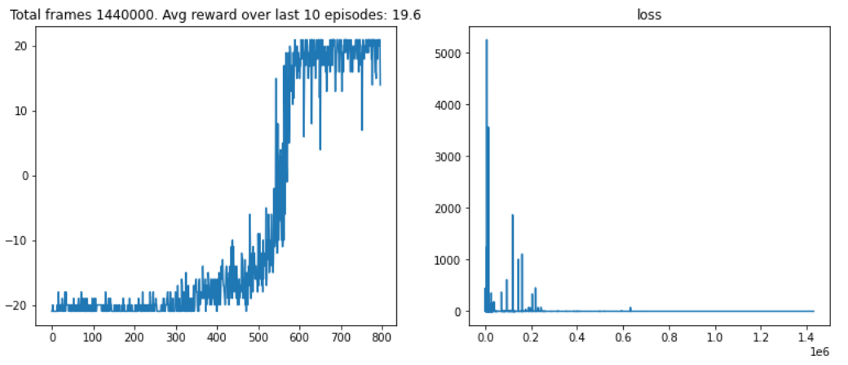
RESULTS (DQN)

Slide 12
RESULTS (DQN)
400 episodes 600 episodes 800 episodes

Slide 13
MODIFICATIONS PROPOSED
Q-Learning algorithms suffer from substantial overestimations of Q-values because they include a maximization step over estimated Q-values. The Double Deep Q-Learning Algorithm (DDQN) attempts to solve this problem
DDQN uses two separate Q-value estimators (2 neural networks), one for action selection (Q`) and the other for action evaluation (Q). Using these independent estimators, we can avoid the maximization bias by disentangling our updates from biased estimates
In order to update Q, we estimate the Q-value of the next state using Q’.
Q’ is updated by periodically hard-copying the parameters of Q’ with that of Q

Slide 14
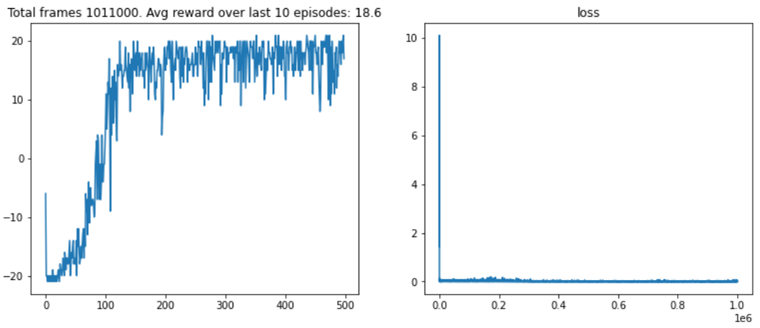
RESULTS (DDQN)

Slide 15
RESULTS (DDQN)
100 episodes 300 episodes

Slide 16
DISCUSSION AND FUTURE WORK
Our DQN and DDQN deep RL models are able to learn to master the Atari Pong game with SOTA results and better than human performance
Pong was chosen due to our limited time and computational resources. We are currently testing this model’s performance without changes on other Atari games like Boxing and Breakout
Going forward, Prioritized Experience Replay can be implemented to reduce noisy training and achieve faster learning

Slide 17
PRELIMINARY RESULTS - BOXING (DQN)

Slide 18
PRELIMINARY RESULTS - BREAKOUT (DQN)

Slide 19
Thank You!

